Slide 1



NLP models for the masses with the Quanteda package and a Shiny interface
28.09.2019 | WhyR | Warsaw

Slide 2
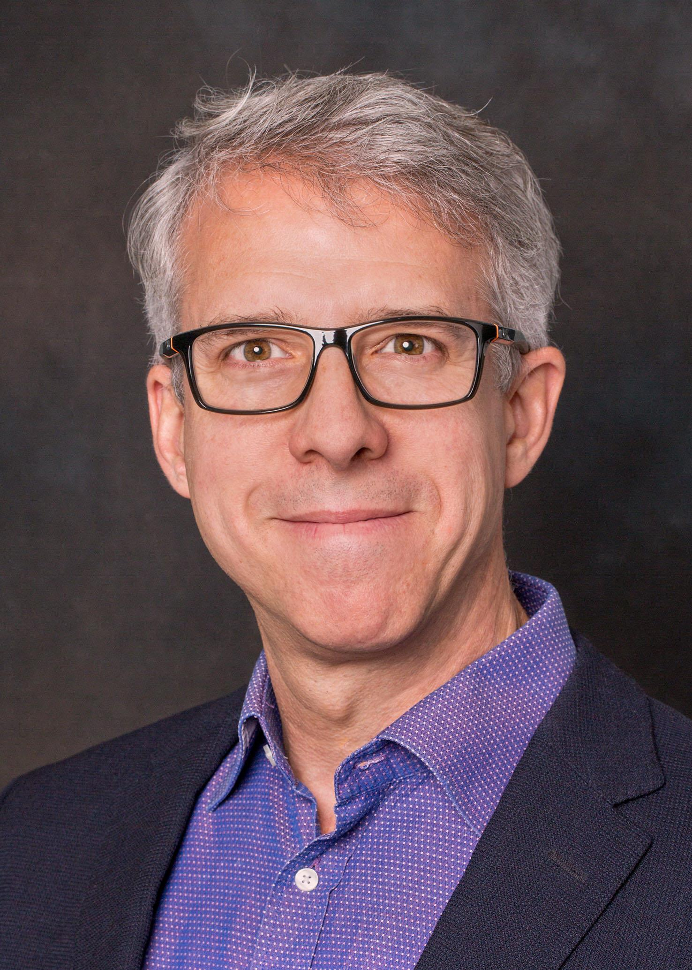


Kenneth Benoit Quanteda Corp / LSE
Professor of Computational Social Science at the London School of Economics and Political Science
Working on processing large amounts of textual data, mainly political texts and social media
Creator/maintainer of the quanteda R package
Founder of Quanteda Corp Limited
Notes:
Let me briefly introduce myself. My name is Damian. It’s my first time at SER. I always wanted to join you I am very happy that I have a chance to give a talk to you today! I’m a cofounder of Appsilon Data Science. We are a boutique Data Science consulting company and we work with companies in different industries to build end-to-end data science solutions for them. We focus on data, models and interface. And we use R a lot in all three.

Slide 3
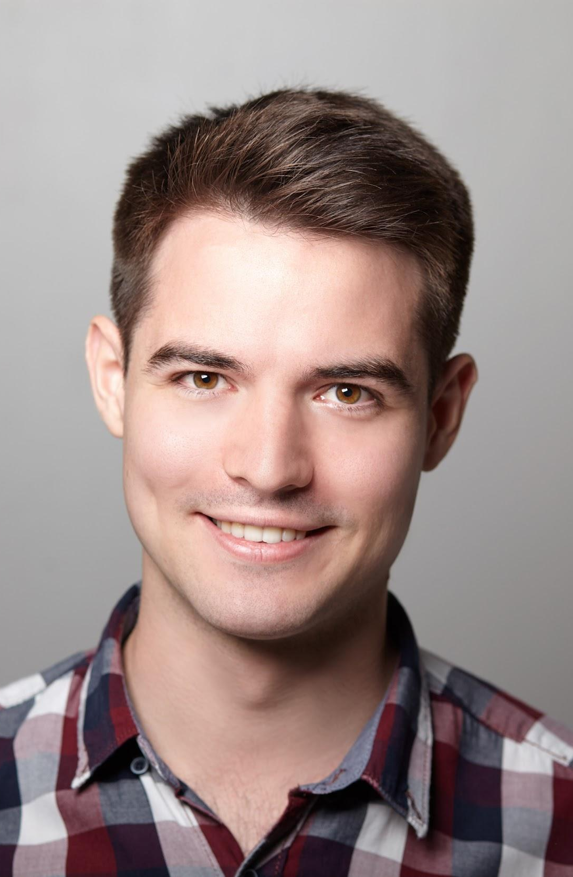
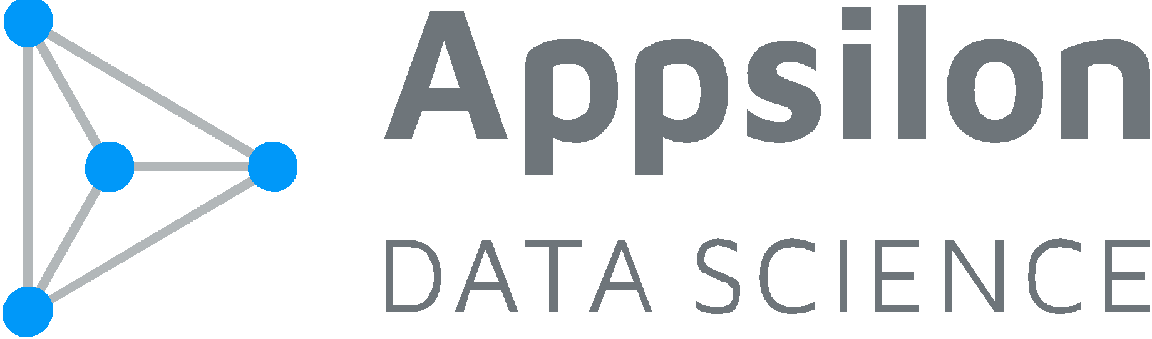
Damian Rodziewicz Vice-president of the Board
Passionate about Data Analysis and Programming
Previously worked at Accenture, UBS, Microsoft, Domino Data Lab
Technology maniac
Loves psychology
Notes:
Let me briefly introduce myself. My name is Damian. It’s my first time at SER. I always wanted to join you I am very happy that I have a chance to give a talk to you today! I’m a cofounder of Appsilon Data Science. We are a boutique Data Science consulting company and we work with companies in different industries to build end-to-end data science solutions for them. We focus on data, models and interface. And we use R a lot in all three.

Slide 4

Agenda
Introduction to the Quanteda package
Quanteda GUI
Building a large scale Shiny application

Slide 5
Quanteda

Slide 6
Introduction to the quanteda package
quantitative analysis of textual data: a mixture of text processing (NLP) and functions for quantitative analysis of text
NLP: storing and processing of corpus meta-data, tokenization, extensive token manipulation functions
fast, flexible functions for creating matrix objects, both document-feature matrices and feature co-occurrence matrices
implements textual statistics, machine learning, scaling models, and discovery functions, and operates well with other text modelling and ML packages

Slide 7
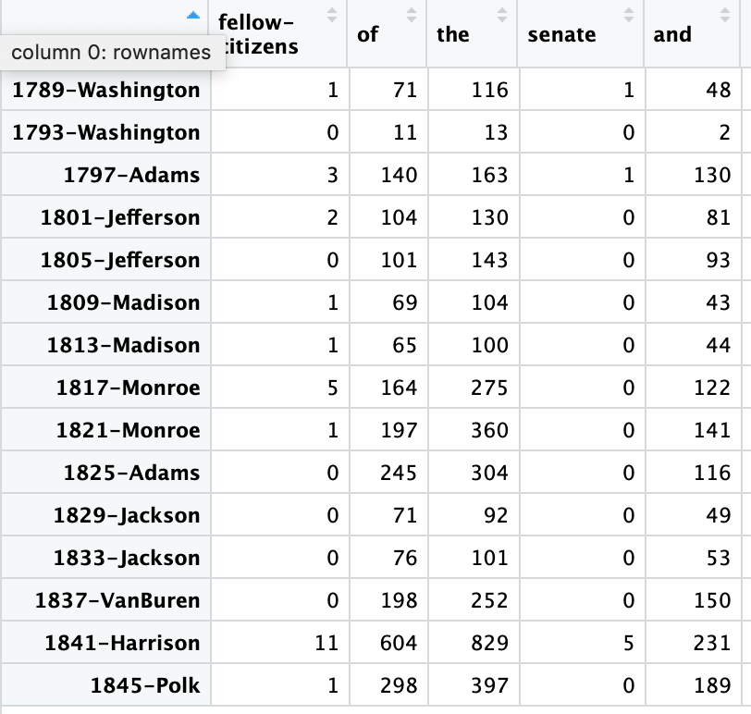
Raw texts
Matrix representation
Analytics
Fellow-Citizens of the Senate and of the House of Representatives: Among the vicissitudes incident to life...
tokenization
feature selection
Statistics:
Term frequencies
Keyness
Readability
Lexical diversity
Similarity, distance
Models
Supervised ML
Unsupervised ML
Scaling
“Word embeddings”
Topic models
Plots
Keyness, networks, scaling, word clouds, “x-ray”
Fellow citizens, I am again called upon by the voice of my country to execute the functions of its Chief Magistrate. When the occasion
When it was first perceived, in early times, that no middle course for America remained between unlimited submission to a foreign legislature

Slide 8
dfm functions
fcm()
dfm_group()
dfm_lookup()
dfm_sample()
dfm_select(), dfm_remove()
dfm_sort()
dfm_tolower()
dfm_trim()
dfm_weight()
dfm_wordstem()
tokens functions
tokens_compound()
tokens_lookup()
tokens_select(), tokens_remove()
tokens_ngrams(), tokens_skipgrams()
tokens_tolower(), tokens_toupper()
tokens_wordstem()
text stat/model/plot fns
textmodel_ca() textmodel_wordfish() textmodel_wordscores() textmodel_affinity() textmodel_nb() textmodel_svm()
textstat_collocations() textstat_dist() textstat_keyness() textstat_lexdiv() textstat_readability()
textplot_scale1d() textplot_wordcloud() textplot_xray() textplot_keyness()
corpus functions
corpus()
corpus_reshape()
corpus_sample()
corpus_segment()
corpus_subset()
corpus_trim()

Slide 9
library("quanteda")
data(data_corpus_movies, package = "quanteda.corpora")
toks <- tokens(data_corpus_movies, remove_punct = TRUE, remove_numbers = TRUE) %>%
tokens_remove(pattern = stopwords("en"))
dfmat <- dfm(toks, groups = "Sentiment")
textstat_keyness(dfmat, target = "pos", measure = "chi2") %>%
textplot_keyness()

Slide 10
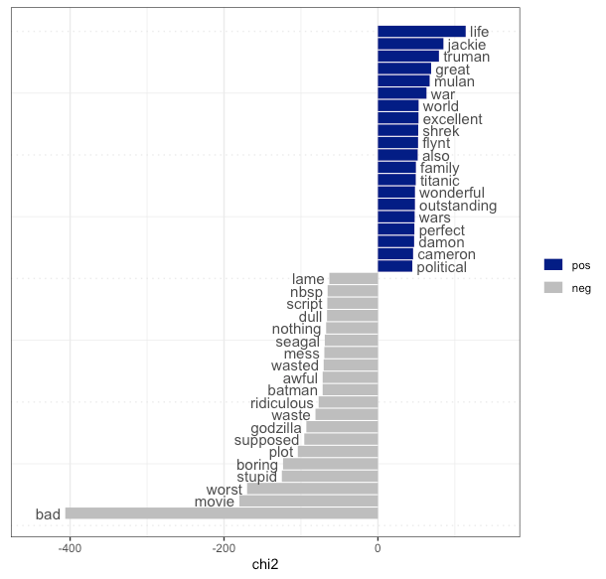

Slide 11
Quanteda GUI

Slide 12
AIM: To reach non-programmer target users
ACADEMIC
Researchers and students who are not R programmers
INDUSTRY
Marketing, analysis, research, legal, media, etc.
POLICY
Government, NGOs, INGOs, policy advisory groups

Slide 13
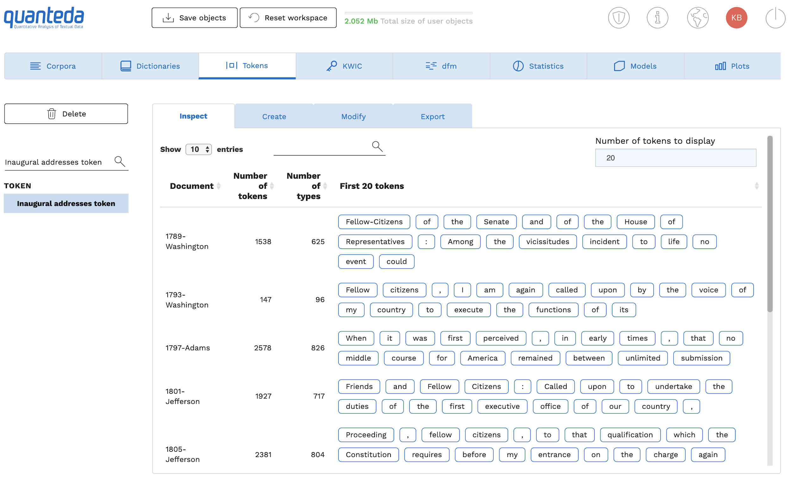

Slide 14
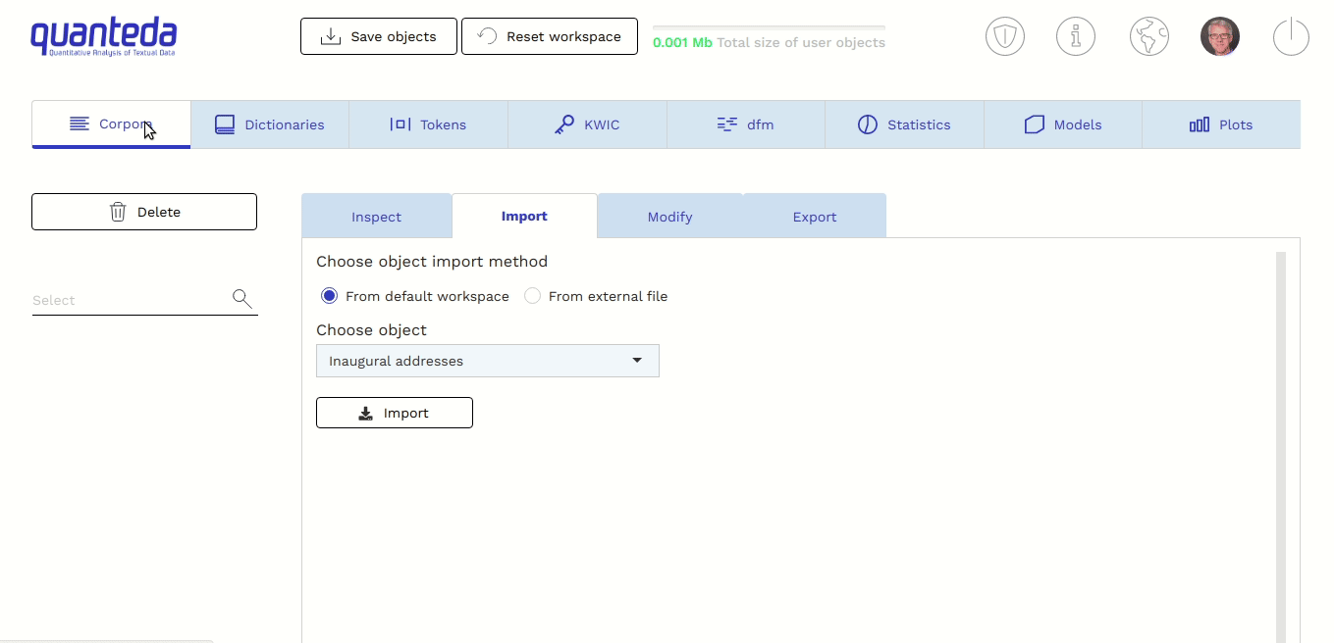

Slide 15
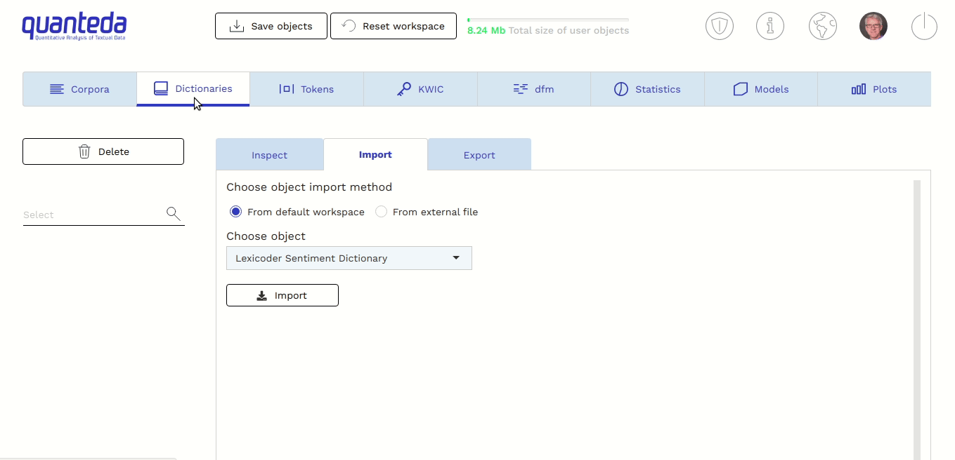

Slide 16
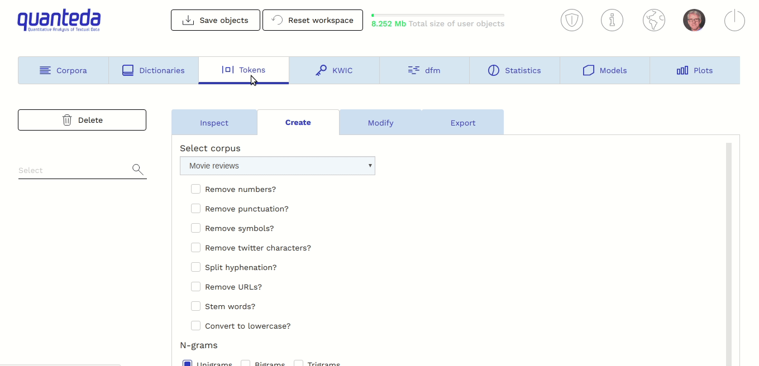

Slide 17
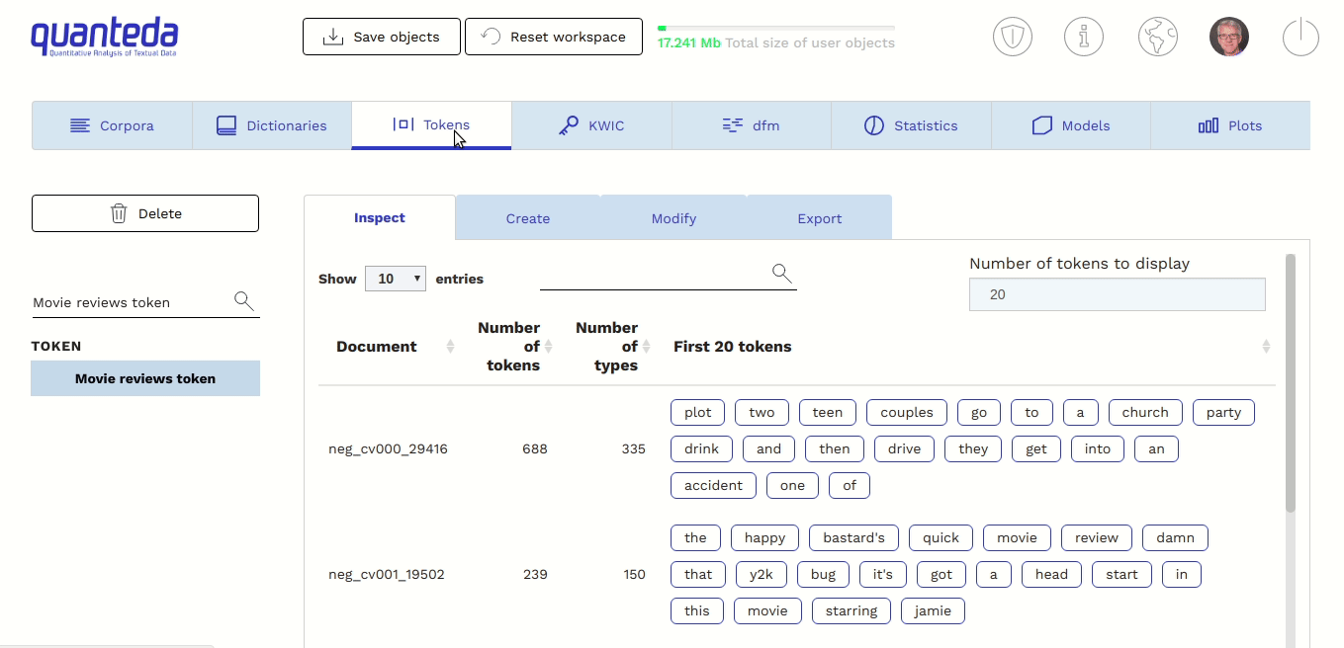

Slide 18
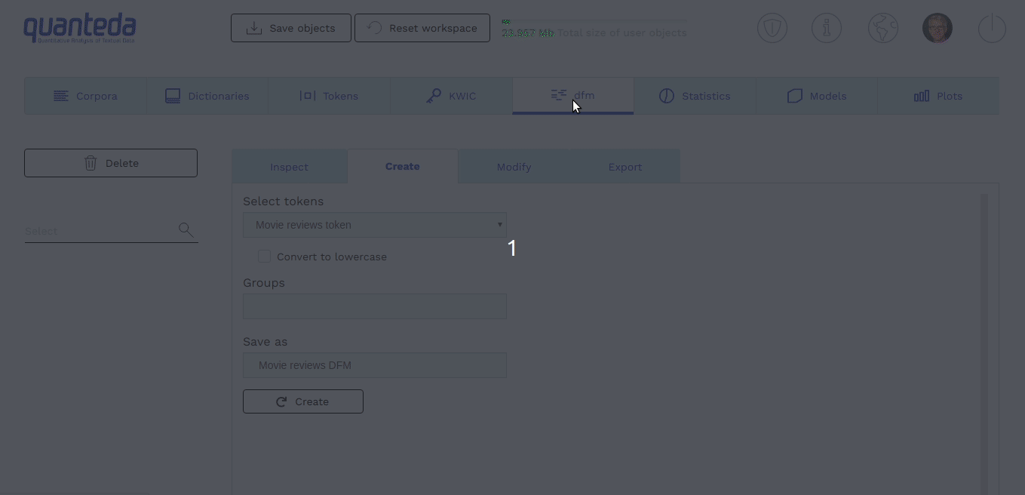

Slide 19
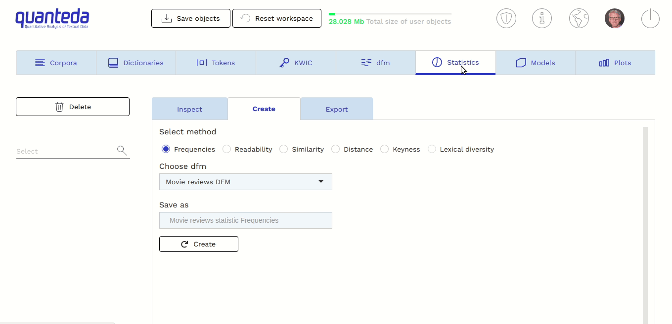

Slide 20
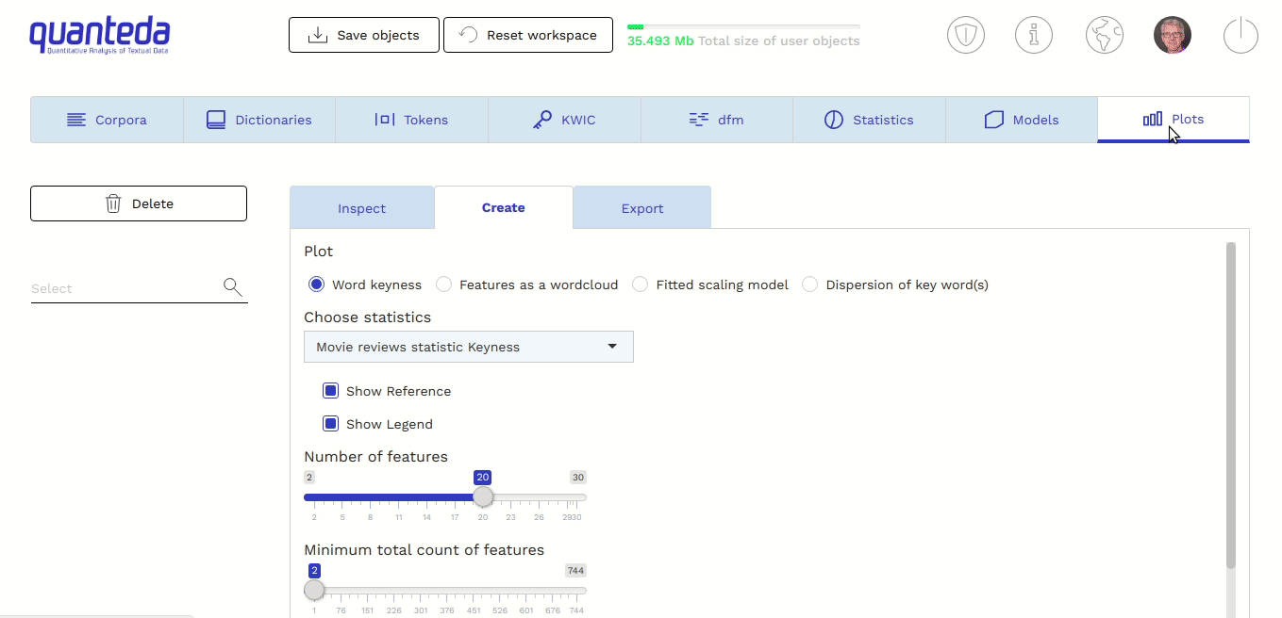

Slide 21
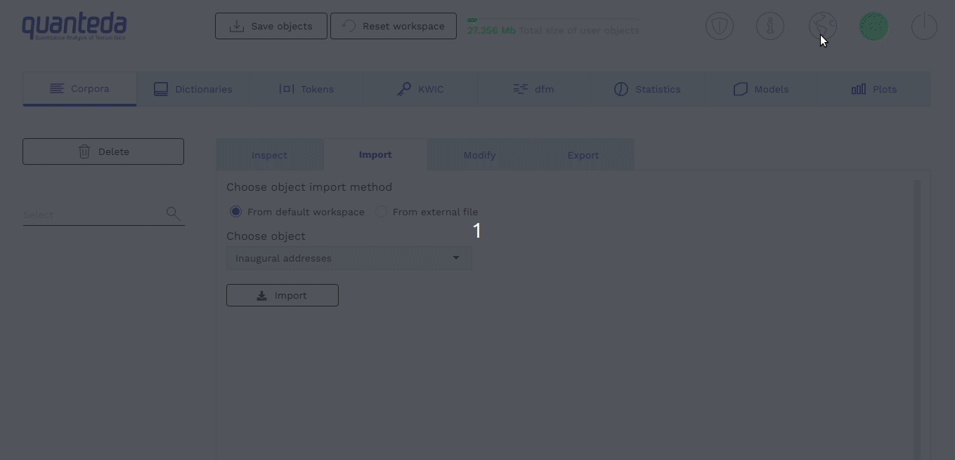

Slide 22
Building large scale Shiny application

Slide 23
Designing the product

Slide 24
Product design
FEEDBACK
LOOP
Get end-users’ feedback as early and as often as possible
FAST
ITERATIONS
Short iterations in Scrum methodology that result in product increments
CONTINUOUS DEPLOYMENT
Automate deployment process, share results constantly

Slide 25
Beautiful UI

Slide 26


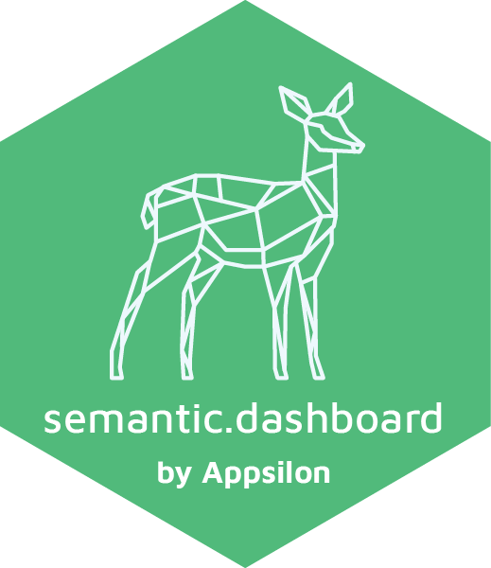


Fast iterations LAVERAGE OPEN SOURCE

Slide 27

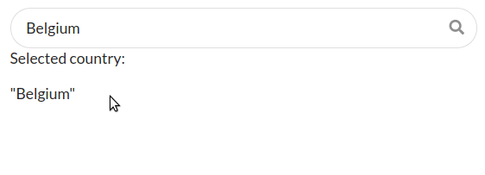
shiny.semantic SEMANTIC UI IN SHINY
Downloads and imports Semantic UI CSS classes
Enabling the user to define Shiny (text) inputs
Contains ready to use pre-defined more complex elements as R functions
Multiple selection search dropdown
Search field
Notes:
downloads and imports Semantic UI CSS classes
creates the abstraction enabling the user to define Shiny (text) inputs
contains ready to use pre-defined more complex elements as R functions
components demo demo.appsilondatascience.com/shiny-semantic-components/

Slide 28
shiny.i18n INTERNATIONALIZATION
i18n <- Translator$new(translations_csvs_path = "/")
i18n$set_translation_language("en")
ui <- shinyUI(fluidPage(
titlePanel(i18n$t("Hello Shiny!"))
))
Loads csv with translations
Sets translations language
Translates the selected element

Slide 29
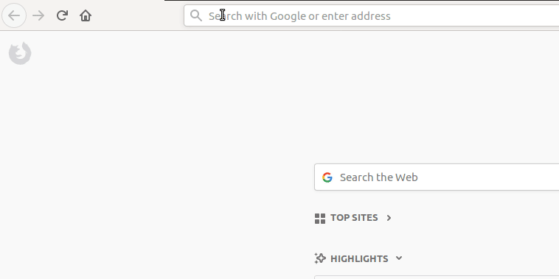
shiny.router URL PARAMETRIZATION
http://example.com/over/there?param=value
Extract params in Shiny
get_query_param()

Slide 30
Scale

Slide 31
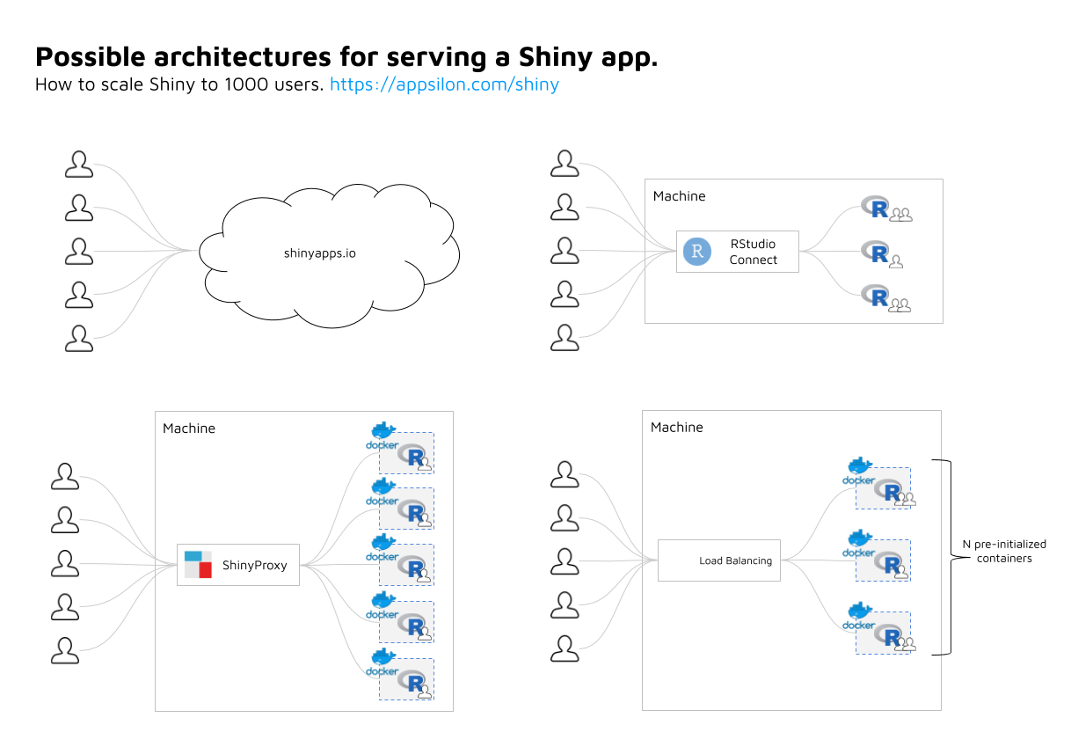

Slide 32




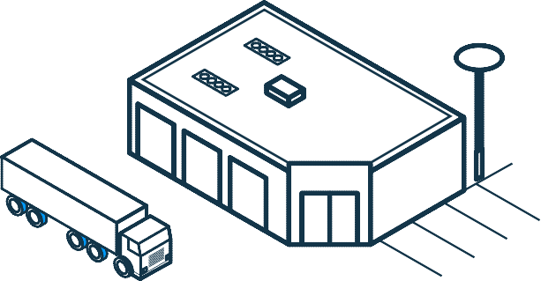
We’re hiring!
Explore the world and apply data science in different industries
appsilon.com/careers
fb.com/appsilondatascience
FINANCE & INSURANCE
RETAIL & ECOMMERCE
LOGISTICS
HEALTH
REAL ESTATE
OTHER

Slide 33
Resources
https://quanteda.org
https://quanteda.io
https://appsilon.com/opensource
https://appsilon.com/shiny
https://appsilon.com/careers

Slide 34
Thank you
damian@appsilon.com
@D_Rodziewicz
kbenoit@quanteda.org
@KenBenoit
quanteda.org
appsilon.com

